Slide 1
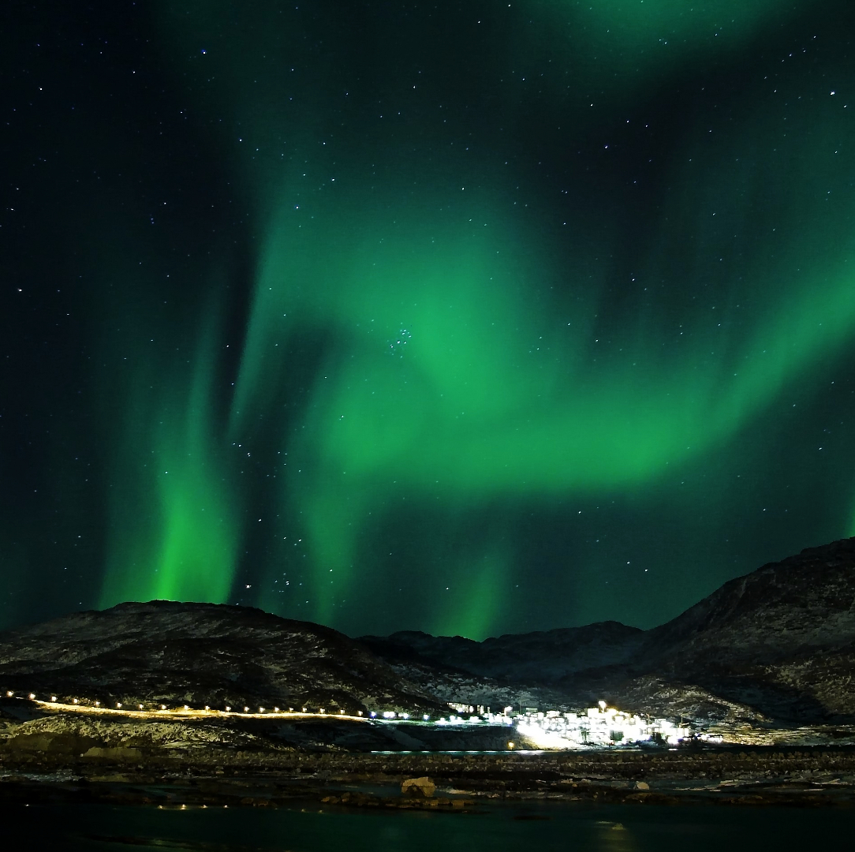
Aurora
Shashank Kumar Reddy
Amulya Gunturu
Sudheer Kumar Chakka

Slide 2
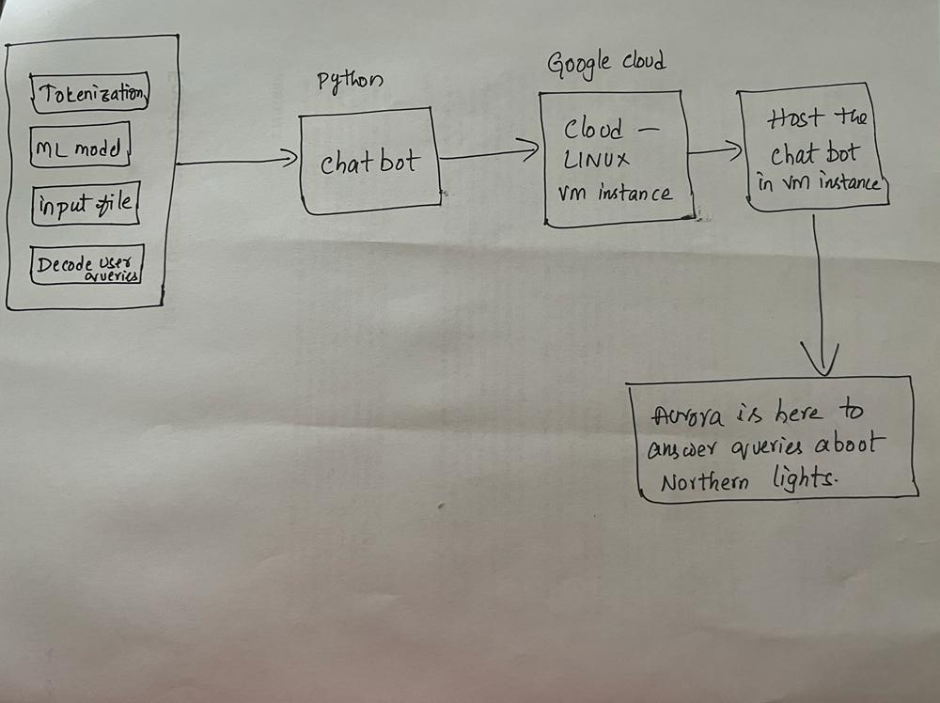
Architecture

Slide 3
What is Aurora?
Why Aurora Chatbot?
Introduction
How can a chatbot answer as a human?
What are the types of chatbots?

Slide 4
Machine Learning Chatbot
Cosine similarity chatbot
TF IDF chatbot.
Types of Chatbots
How to develop a chatbot?

Slide 5
Python
Google co-lab
Tensor flow
NLTK
NumPy
Pickle
tf learn
Google Cloud
Technologies

Slide 6
Data used in this project is in JSON format with tags, patterns and responses.
Data Pre-processing:
Reading a JSON file
Creating a JSON file with Intents.
Stripping punctuation.
Creating a list of words.
Lower case
Data

Slide 7
Tokenize
Stemming
Bag of words
Random Shuffling
Machine learning Techniques
Techniques

Slide 8
What is the Cloud?
Is it something floating over your heads?
Benefits of Cloud
What do you feel about security in Cloud Computing?
Cloud

Slide 9
Machine Type: e2-medium (2 vCPUs, 4 GB Memory)
OS: Debian GNU / Linux
Autoscaling: (min 1, max 5)
Autoscaling Triggers at CPU utilization: 60%
Scale In Controls
Cool down period: 20 Seconds
Configurations
Of
Virtual Machine

Slide 10
What dependencies are required to install for this project?
Issues faced while installing dependencies.
How are they solved?
Dependencies

Slide 11
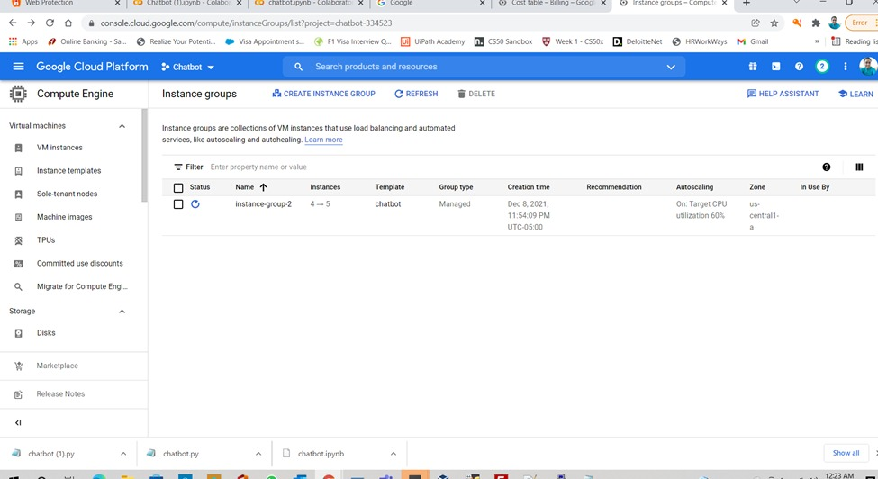
Auto Scaling

Slide 12
How much does it cost to use our VM with 4GB Memory?
Billing
Monthly estimate - $25.46
For 2 vCPU + 4 GB memory - $24.46
10 GB balanced persistent disk - $1.00
Total: $25.46 Compute Engine pricing

Slide 13
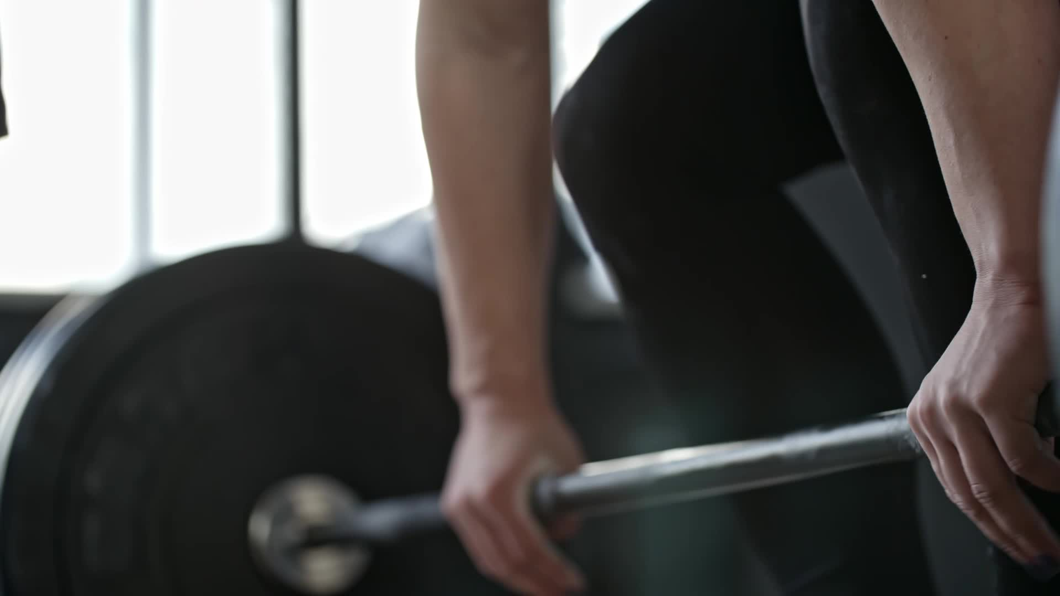
Training Chatbot
Train the chatbot with JSON file.
Test it out.

Slide 14


